Slide 1


Slide 2


Members
Reina
Evelyn
Racquel
Elena

Slide 3


Evelyn
Bachelor’s in Accounting
Wants to learn data science to enhance and advance my career
Currently in banking
Reina
Associates in Business
Currently in Customer/Tech Support
Has taken coding classes before and is learning data science to advance her tech career

Slide 4


Racquel
Currently Dog groomer
Bachelor’s in Biology
Wants to learn data science to enhance her biology degree
Researching requirements for Biology Doctorate
Elena
Currently in Marketing
Wants to learn data science to advance her position

Slide 5













Slide 6
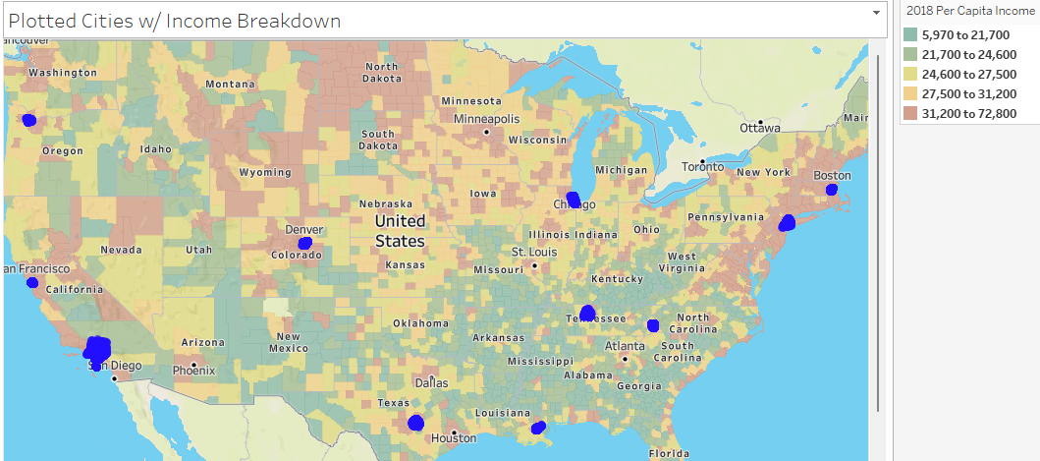
Notes:
Most of our cities are located in high income areas!!

Slide 7

Where to stay?
How to stay?
What to pay?

Slide 8
Airbnb
August 2008
Brian Chesky in San Francisco
Used for vacation rentals, tourism activities

Slide 9
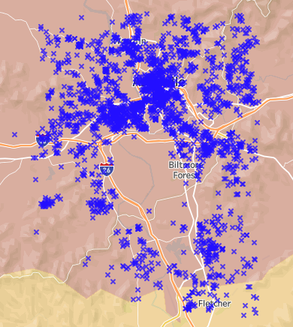
Asheville, North Carolina
Real Estate:
House prices: $403,390
1-bedroom rental: $1,369

Slide 10
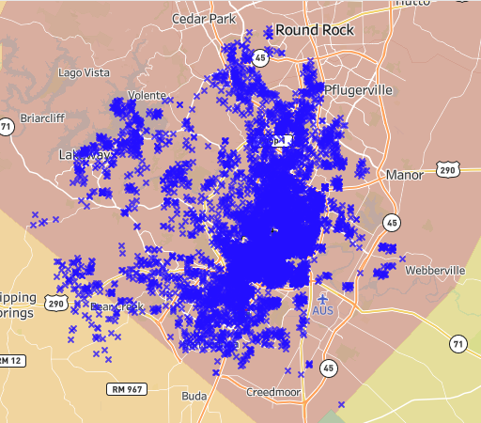
Austin, Texas
Real Estate:
House prices: $655,862
1-bedroom rental: $1,575

Slide 11
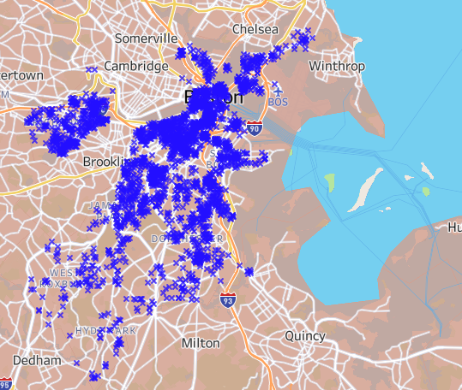
Boston, Massachusetts
Real Estate:
House prices: $718,756
1-bedroom rental: $2,650

Slide 12
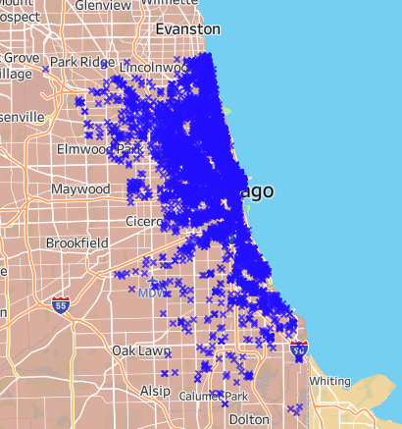
Chicago, Illinois
Real Estate:
House prices: $309,268
1-bedroom rental: $1,595

Slide 13
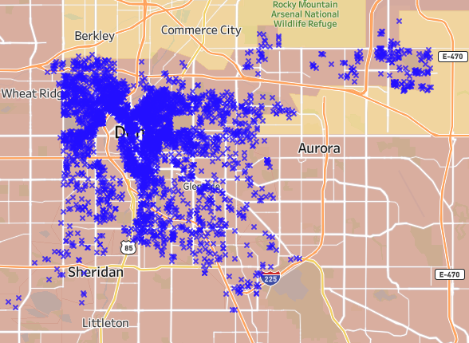
Denver, Colorado
Real Estate:
House prices: $608,955
1-bedroom rental: $1,750

Slide 14
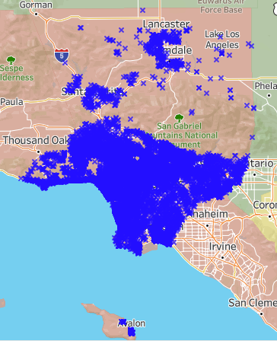
Los Angeles, California
Real Estate:
House prices: $944,651
1-bedroom rental: $2,318

Slide 15
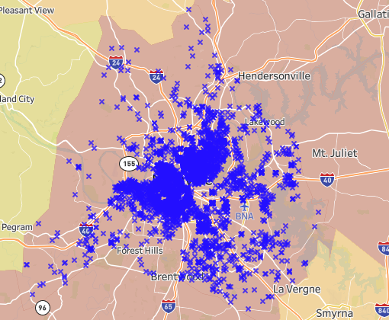
Nasheville, Tennessee
Real Estate:
House prices: $420,533
1-bedroom rental: $1,692

Slide 16
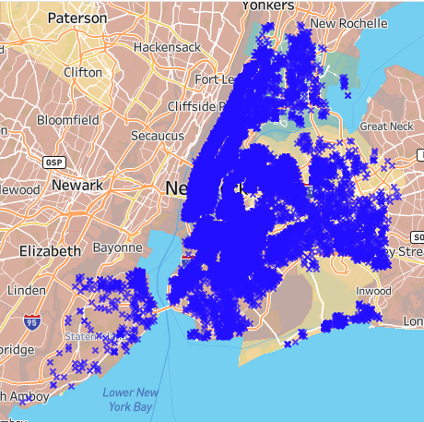
New York City, New York
Real Estate:
House prices: $746,354
1-bedroom rental: $3,295

Slide 17
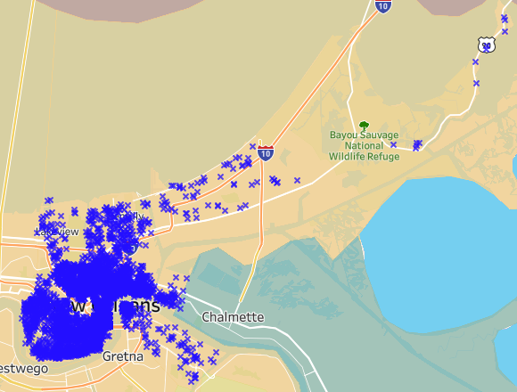
New Orleans, Louisiana
Real Estate:
House prices: $272,125
1-bedroom rental: $1,450

Slide 18
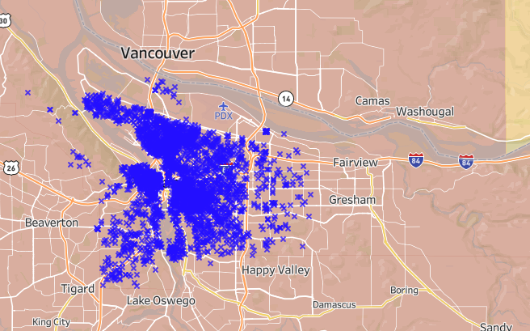
Portland, Oregon
Real Estate:
House prices: $574,291
1-bedroom rental: $1,495

Slide 19
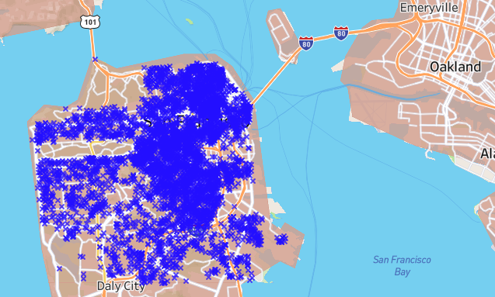
San Francisco, California
Real Estate:
House prices: $1,579,001
1-bedroom rental: $2,929

Slide 20
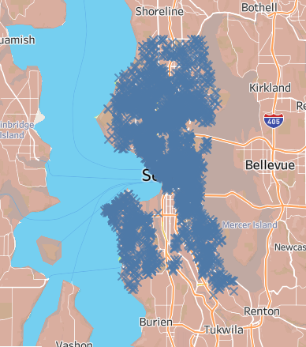
Seattle, Washington
Real Estate:
House prices: $932,382
1-bedroom rental: $1,895

Slide 21
Resources
Where data set was retrieved
http://insideairbnb.com/get-the-data.html
Real Estate prices: last visited march 20, 2022
https://www.zillow.com/new-york-ny/home-values/
https://www.zillow.com/new-orleans-la/home-values/
https://www.zillow.com/asheville-nc/home-values/
https://www.zillow.com/austin-tx/home-values/
https://www.zillow.com/boston-ma/home-values/

Slide 22
Resources
https://www.zillow.com/chicago-il/home-values/
https://www.zillow.com/denver-co/home-values/
https://www.zillow.com/los-angeles-ca/home-values/
https://www.zillow.com/nashville-tn/home-values/
https://www.zillow.com/portland-or/home-values/
https://www.zillow.com/san-francisco-ca/home-values/
https://www.zillow.com/seattle-wa/home-values/

Slide 23
Resources
Rentals: last visited march 20, 2022
https://www.zumper.com/rent-research/austin-tx
https://www.zumper.com/rent-research/asheville-nc
https://www.zumper.com/rent-research/boston-ma
https://www.zumper.com/rent-research/chicago-il
https://www.zumper.com/rent-research/denver-co
https://www.zumper.com/rent-research/los-angeles-ca
https://www.zumper.com/rent-research/nashville-tn

Slide 24
Resources
https://www.zumper.com/rent-research/new-york-ny
https://www.zumper.com/rent-research/new-orleans-la
https://www.zumper.com/rent-research/portland-or
https://www.zumper.com/rent-research/san-francisco-ca
https://www.zumper.com/rent-research/seattle-wa

